Slide 1
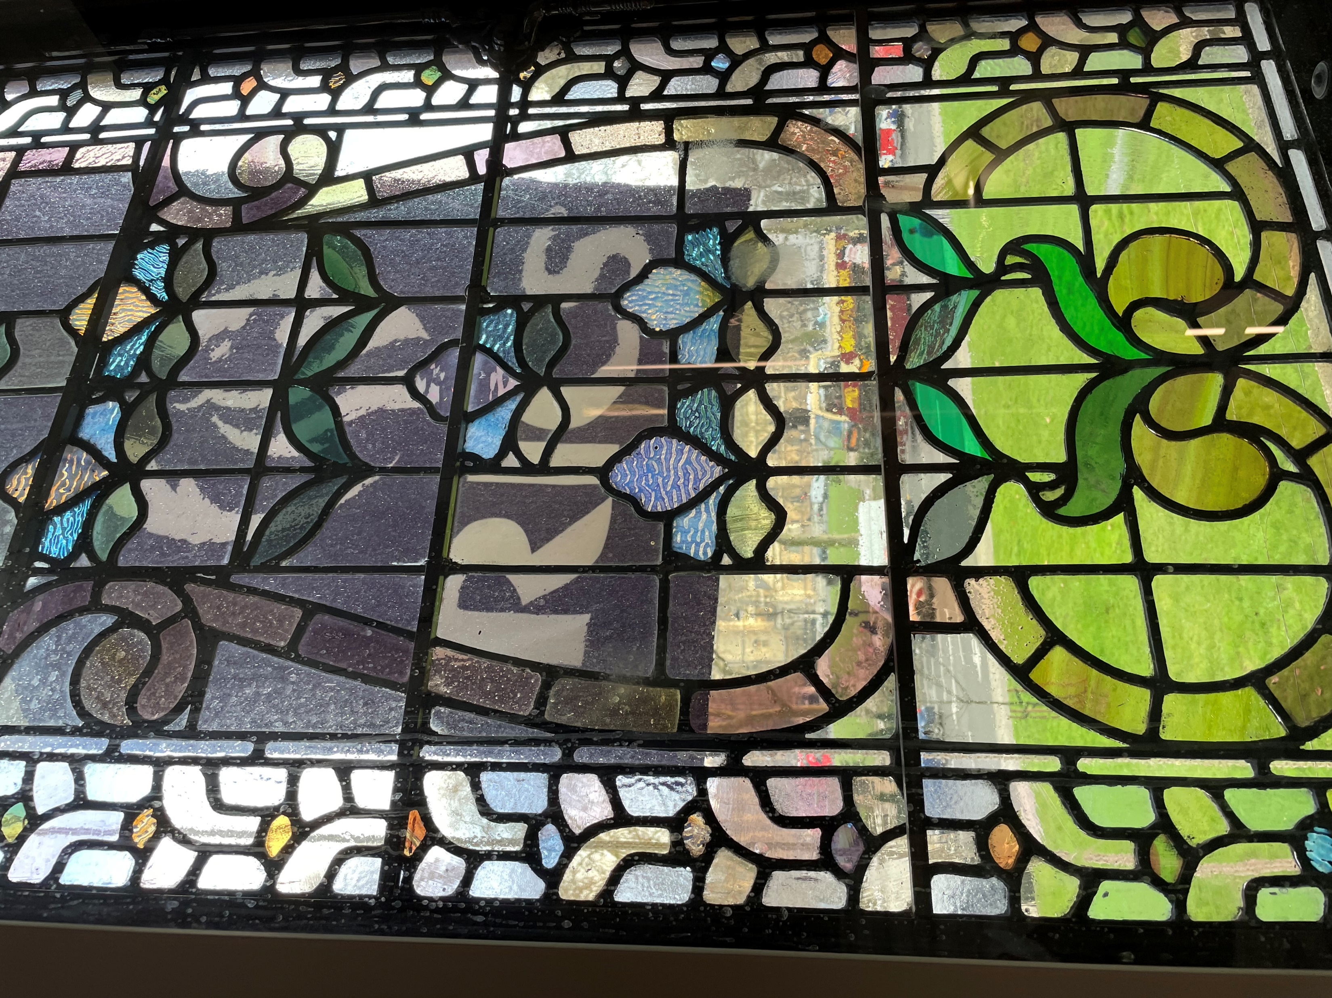
International
Women’s Day
8th March 2023

Slide 3
The National Association of Women In Construction (NAWIC) was founded by Doris Efird and 15 other women on 11 September 1953 in Fort Worth USA. To provide a support system from their female peers, in a charitable and not for profit way. Members were architects, trades people and project managers. NAWIC became a place for all women who wanted to make a difference in their careers, a reality. NAWIC is an inclusive organisation. Any woman working in construction in any way may join.
NAWIC later became an international not for profit organisation dedicated to the advancement of women in construction. Women meet to celebrate their achievements, network and learn from each other. Mutual support is given, along with mentoring younger women and women returners who may have taken a career break to raise a family. There are several branches in the UK.

Slide 4
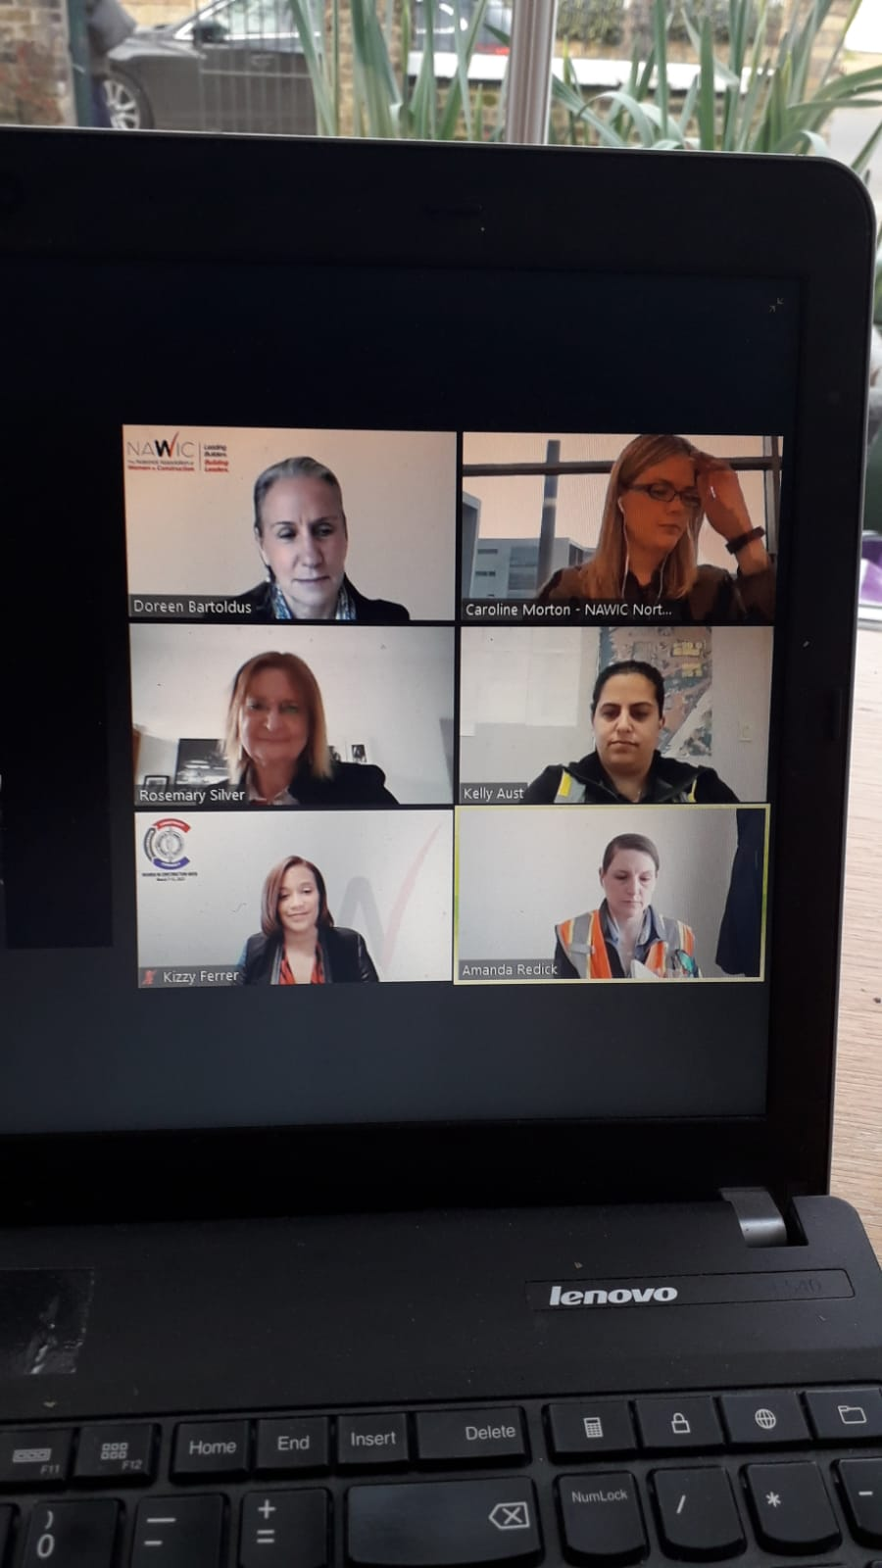
For IWD 2021, for the first time, women from NAWICK USA and UK came together on Zoom to talk about their experiences of working in construction in Covid.
One of the few advantages of Covid, was to have a Zoom event that could unite NAWIC women from the USA and the UK.

Slide 5
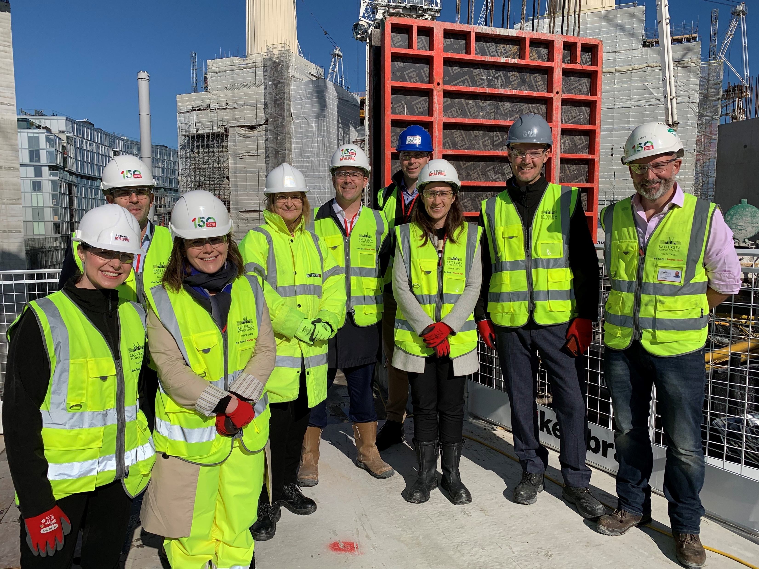
As women in construction, we organise many site visits to explore interesting building projects.
Here at the Battersea Power Station redevelopment in 2019.

Slide 6
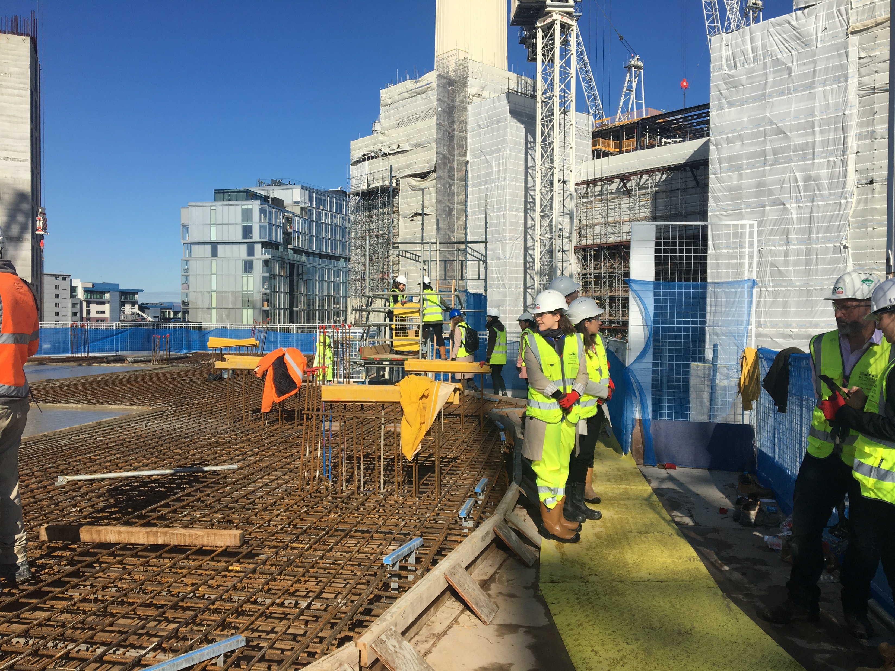

Slide 7
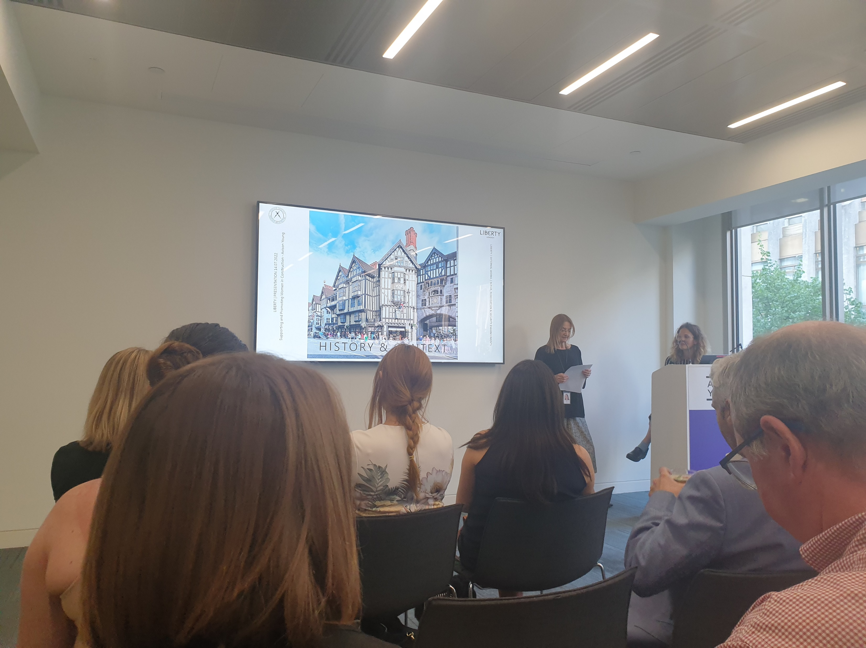
Liberty’s of London
No site visit, as anyone can visit this iconic building.
But the female architects working on the 2020-2022 renovation gave an educational and inspirational talk to NAWIC members about their project

Slide 8
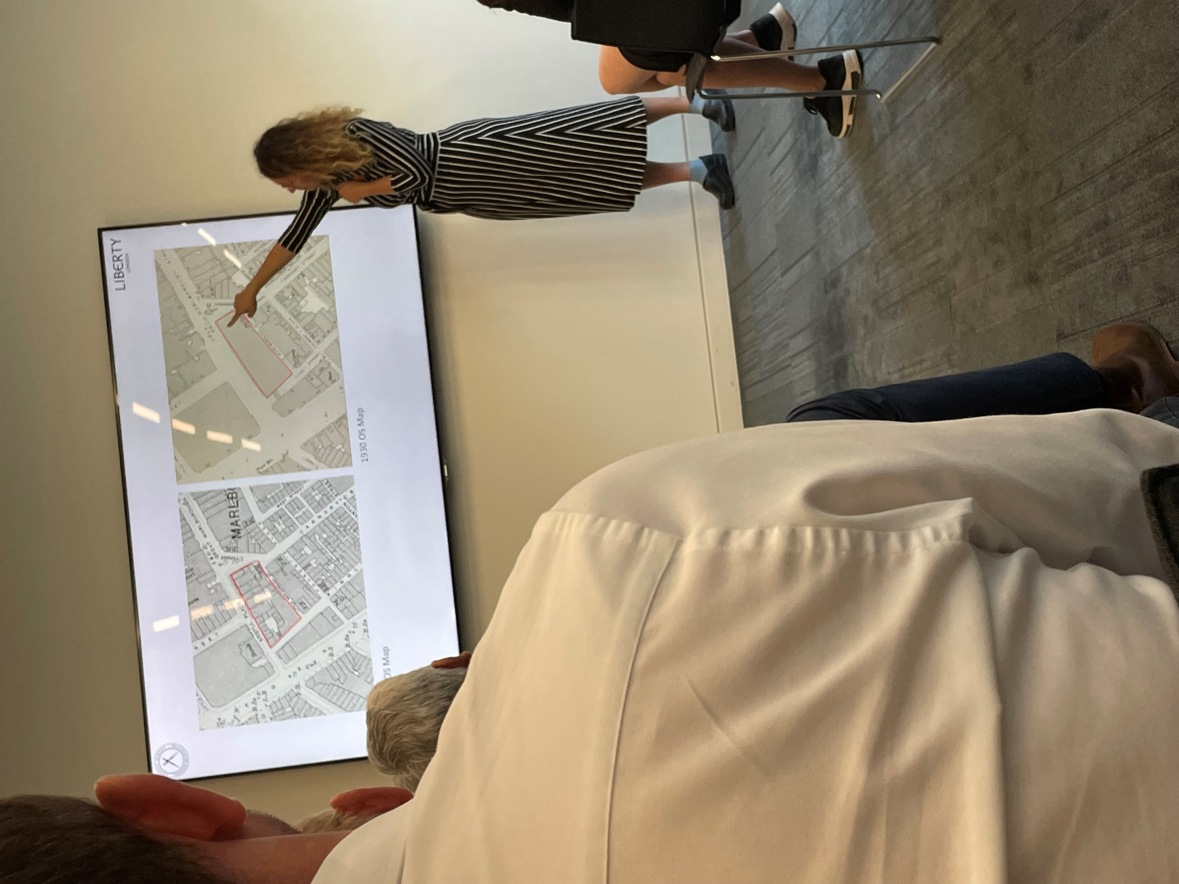
The architect’s tale.
Francesca Cipolla of Heritage Architecture

Slide 9
The conservaterur’s tale.
Kim Reczek of specialist contractors DBR. Kim restored the weather vane in 24 carat gold

Slide 10
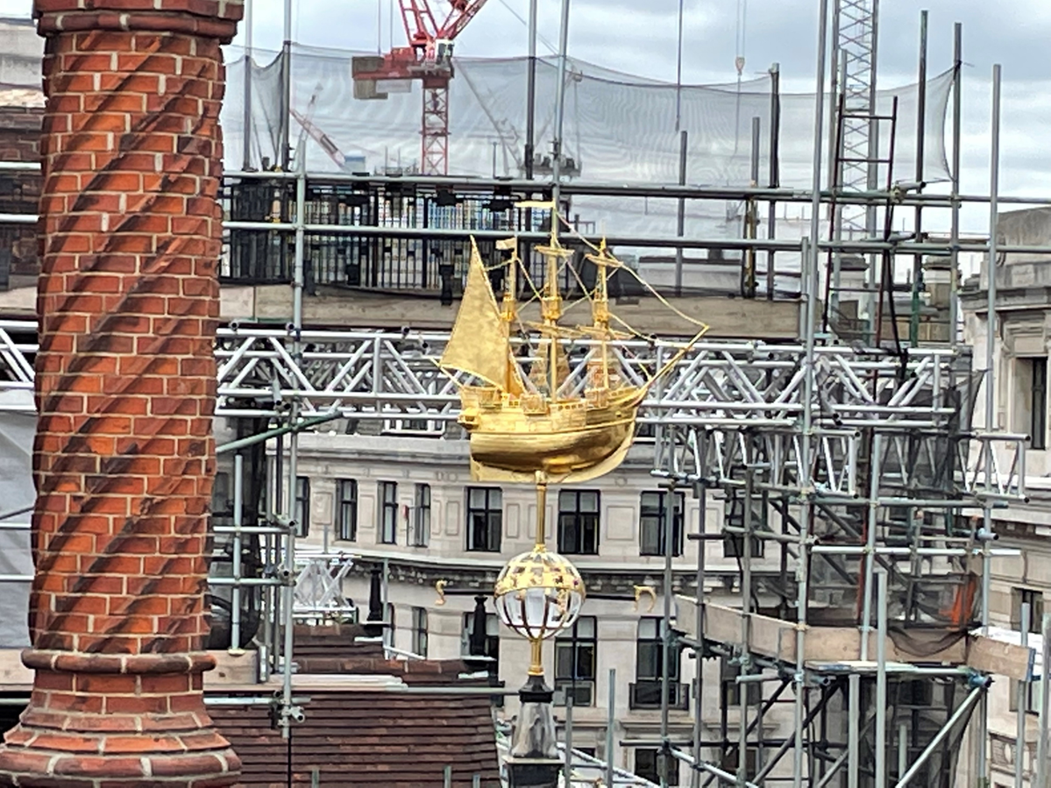

Slide 11
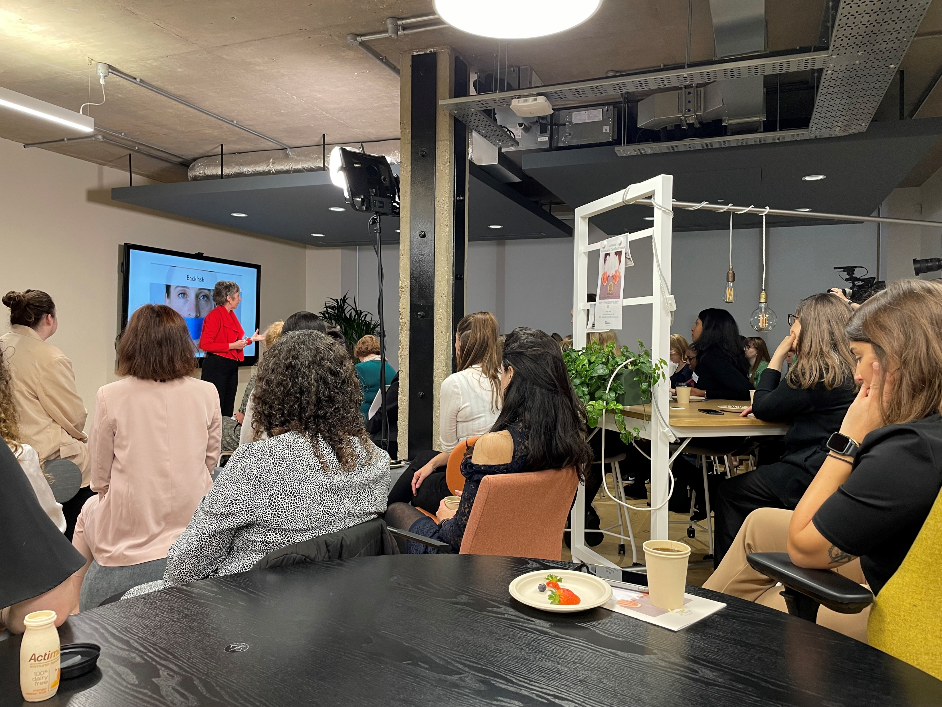
A NAWIC business breakfast meeting in 2022 by an inspirational coach

Slide 12
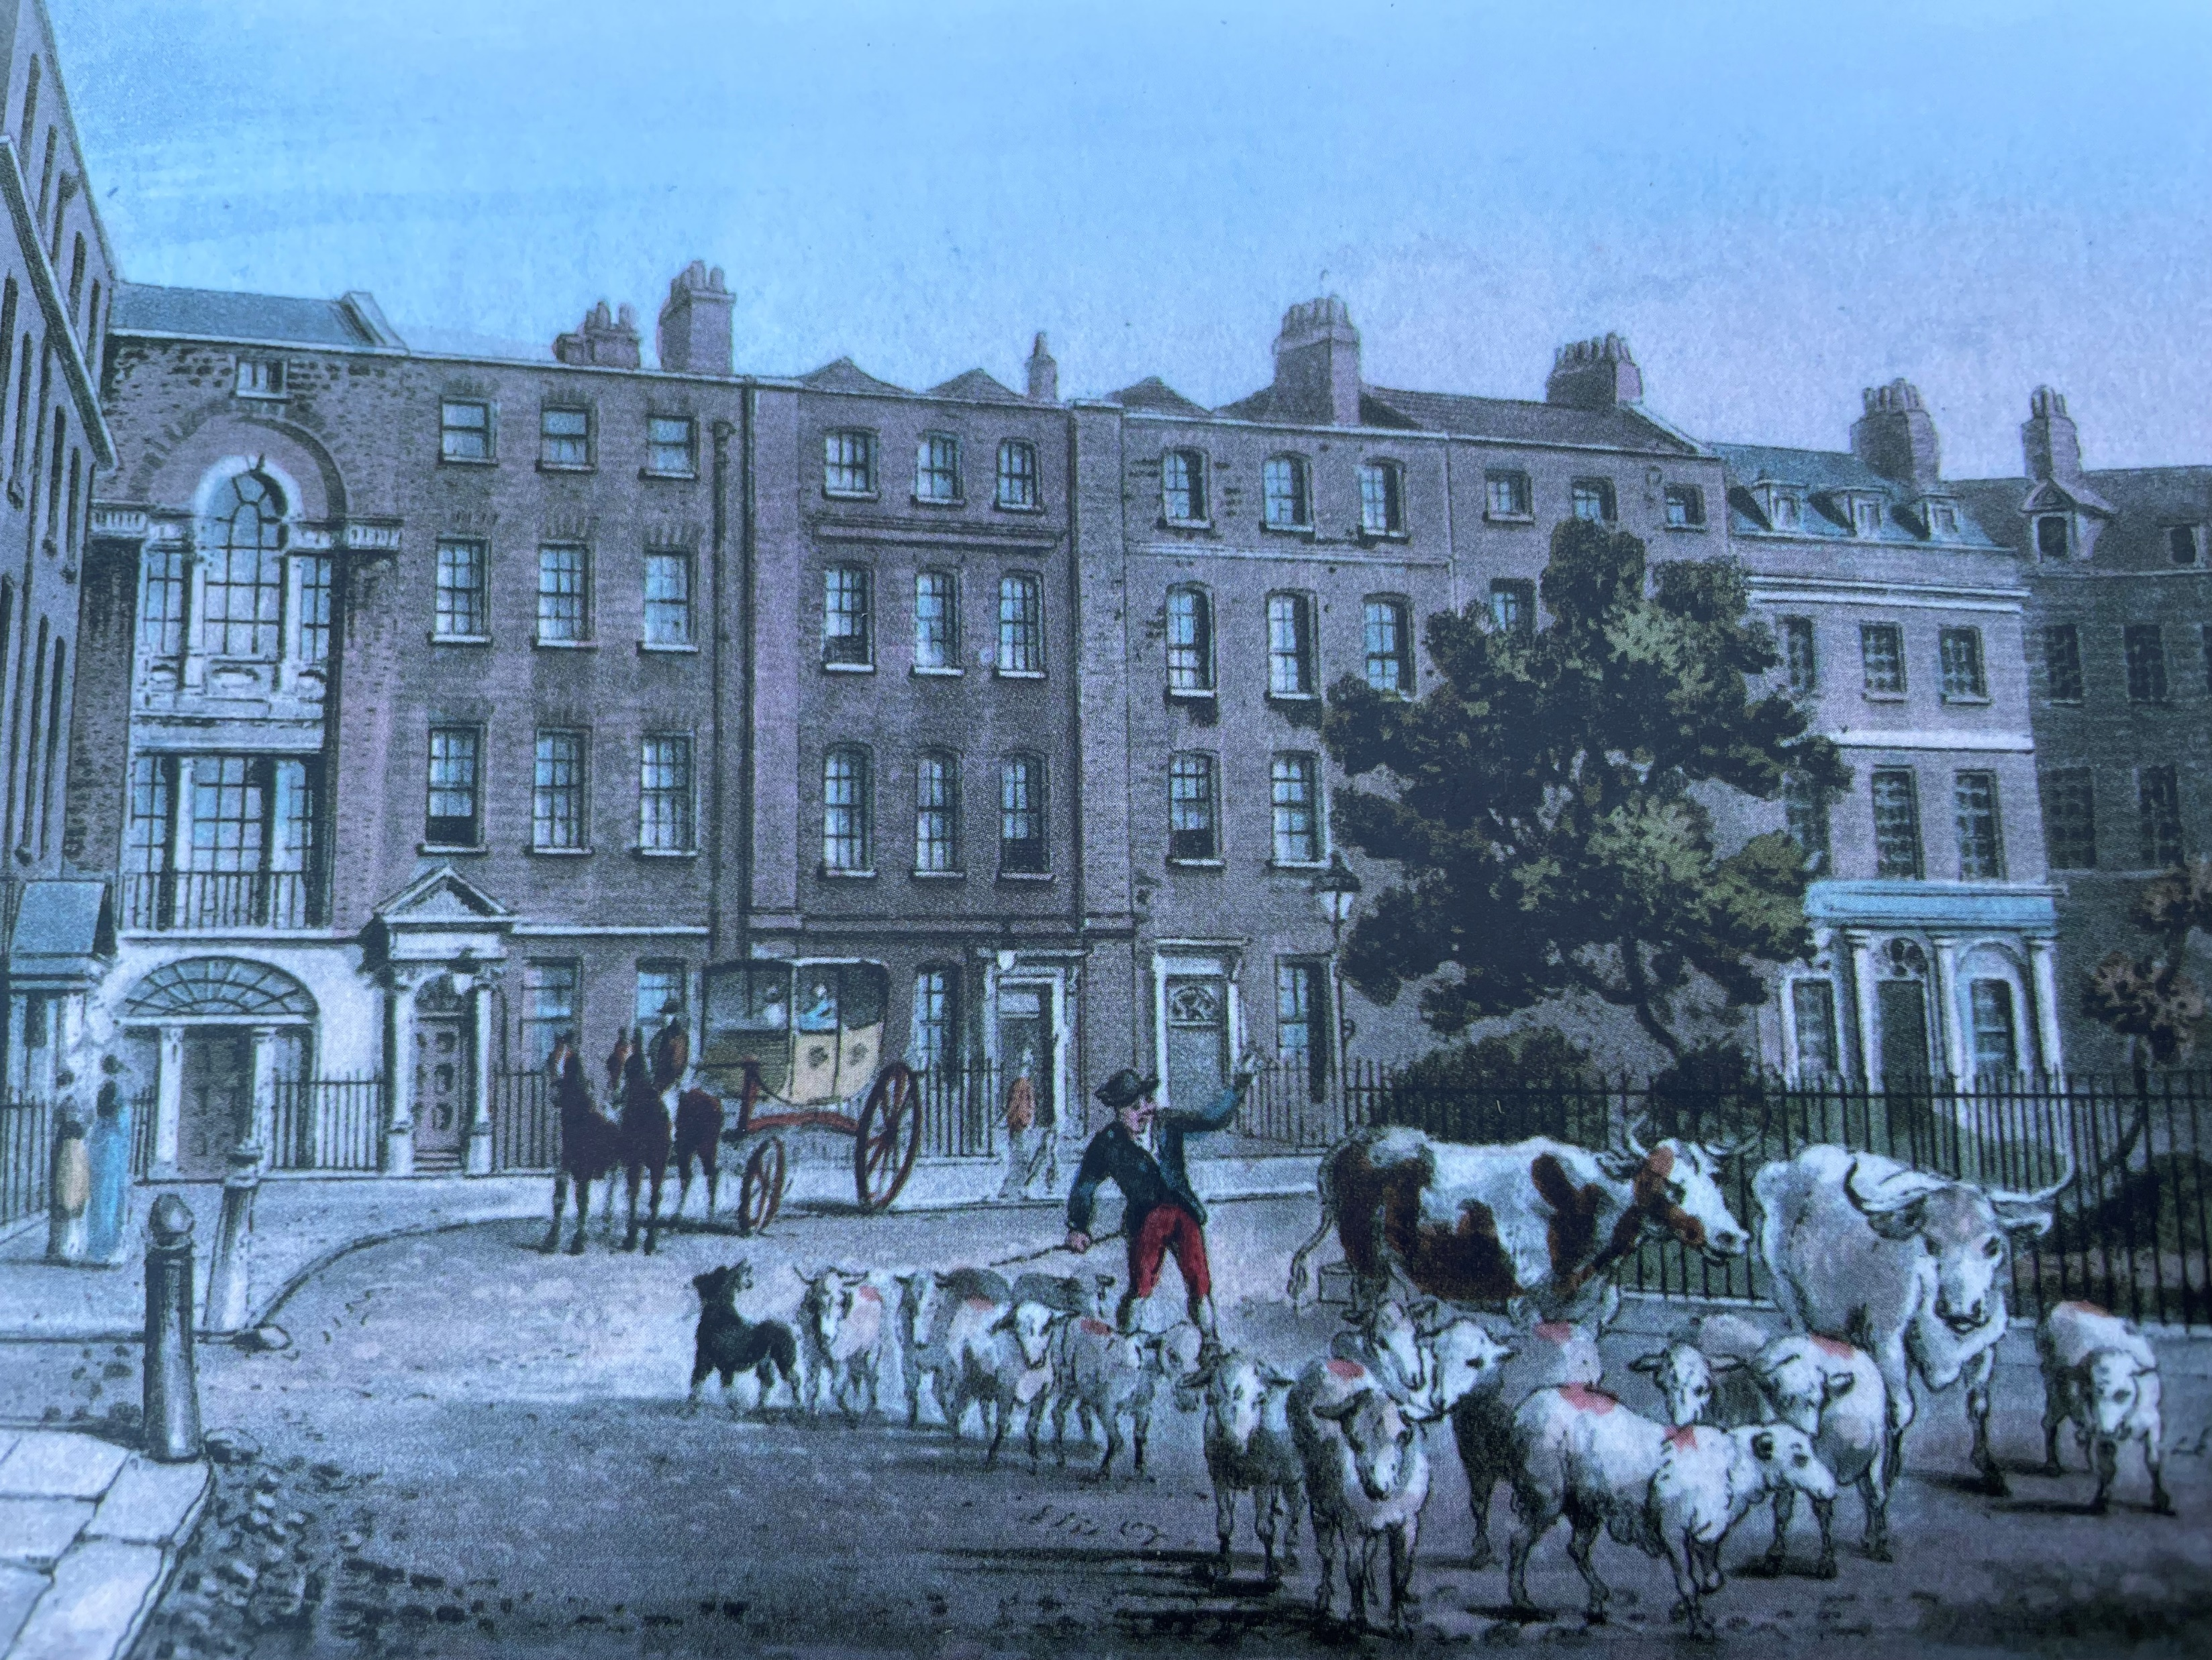
Two walking tours of the history of garden squares in Islington and Clerkenwell

Slide 13
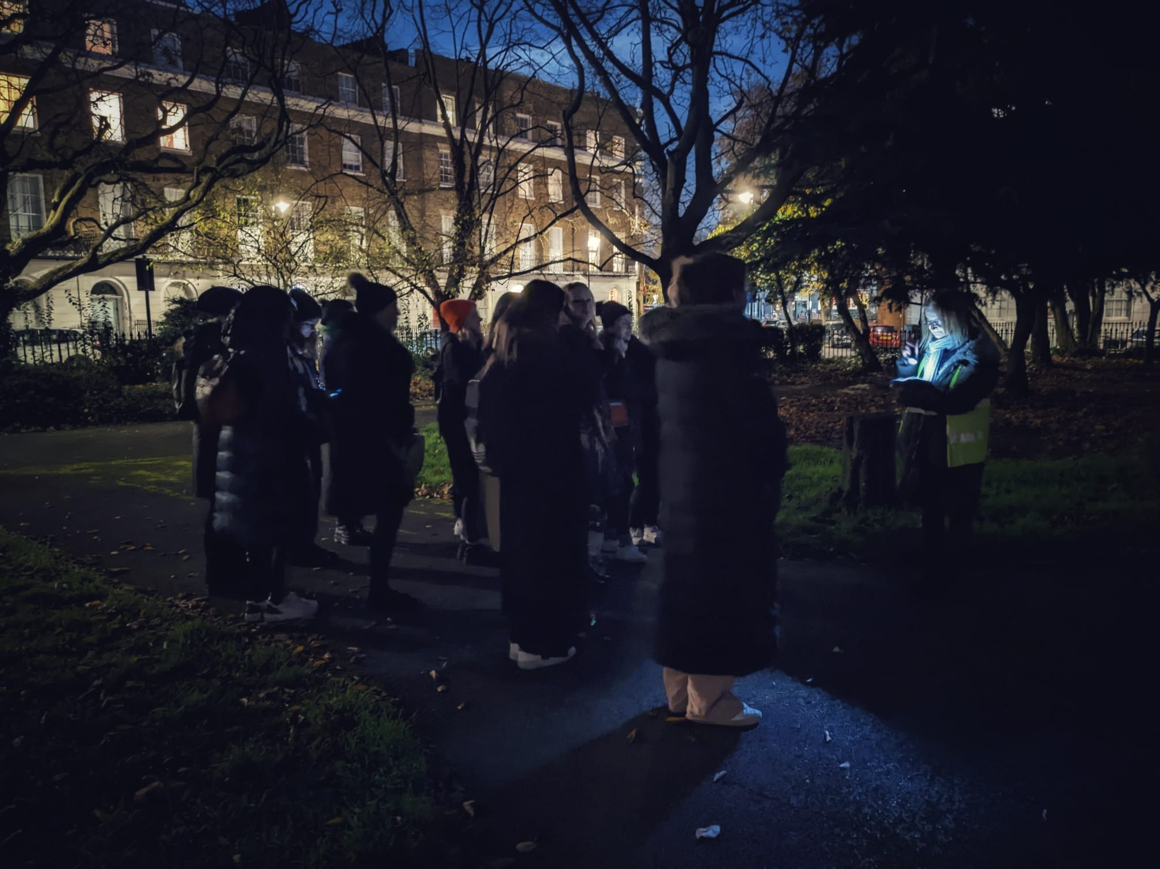
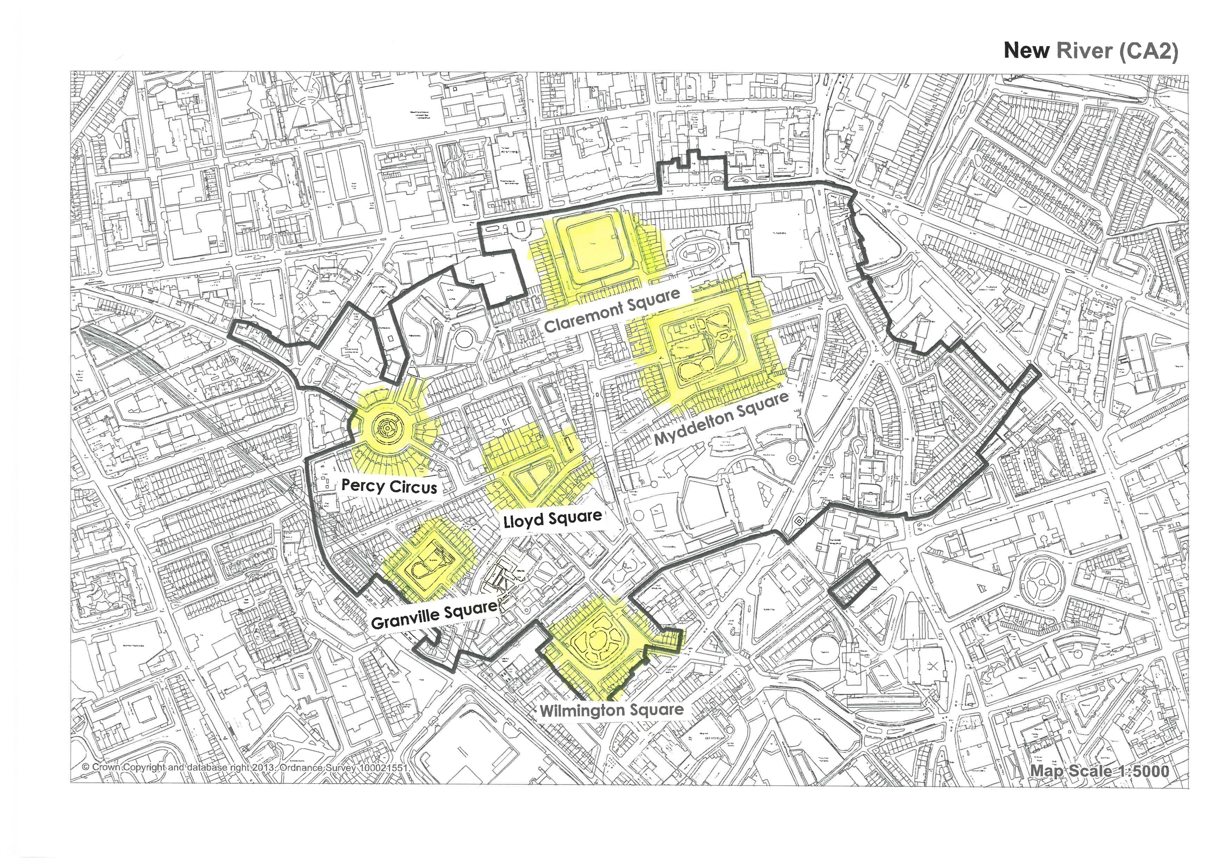
Myddelton Square by moonlight in December 2022 2022Xmas event Xma

Slide 14
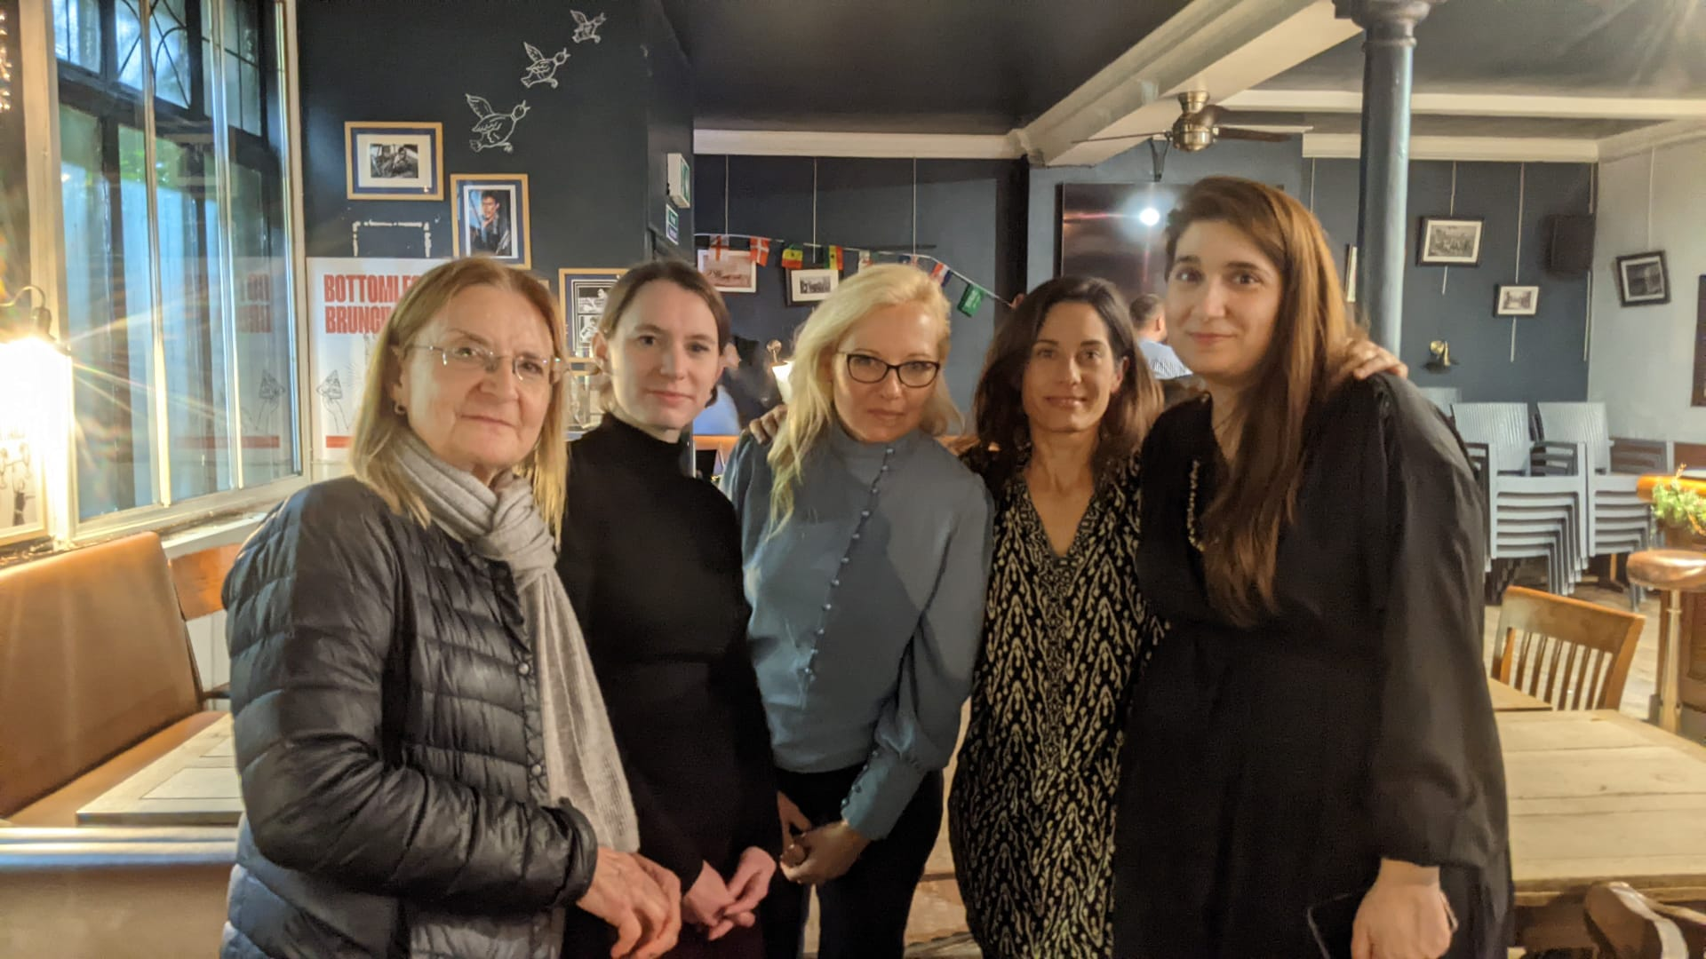
We warmed up for networking drinks afterwards.
Here are the last of the committee members at the end of the evening

Slide 15
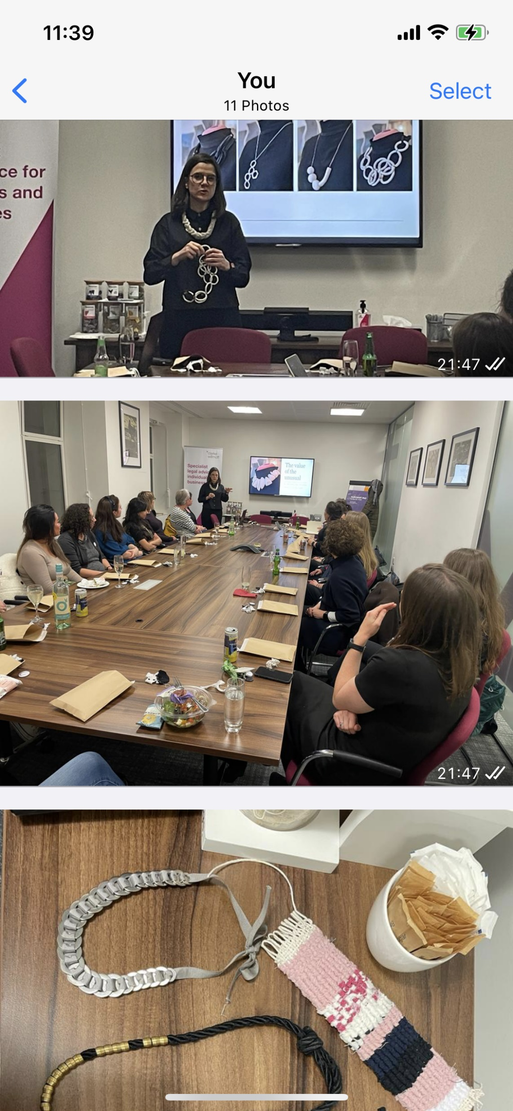
In January 2023, Cristina Lanz Azcarate, former London NAWIC Chair, led a fabulous evening workshop.
Making jewellery out of building materials, and recycled tights.
Here is my necklace.

Slide 16
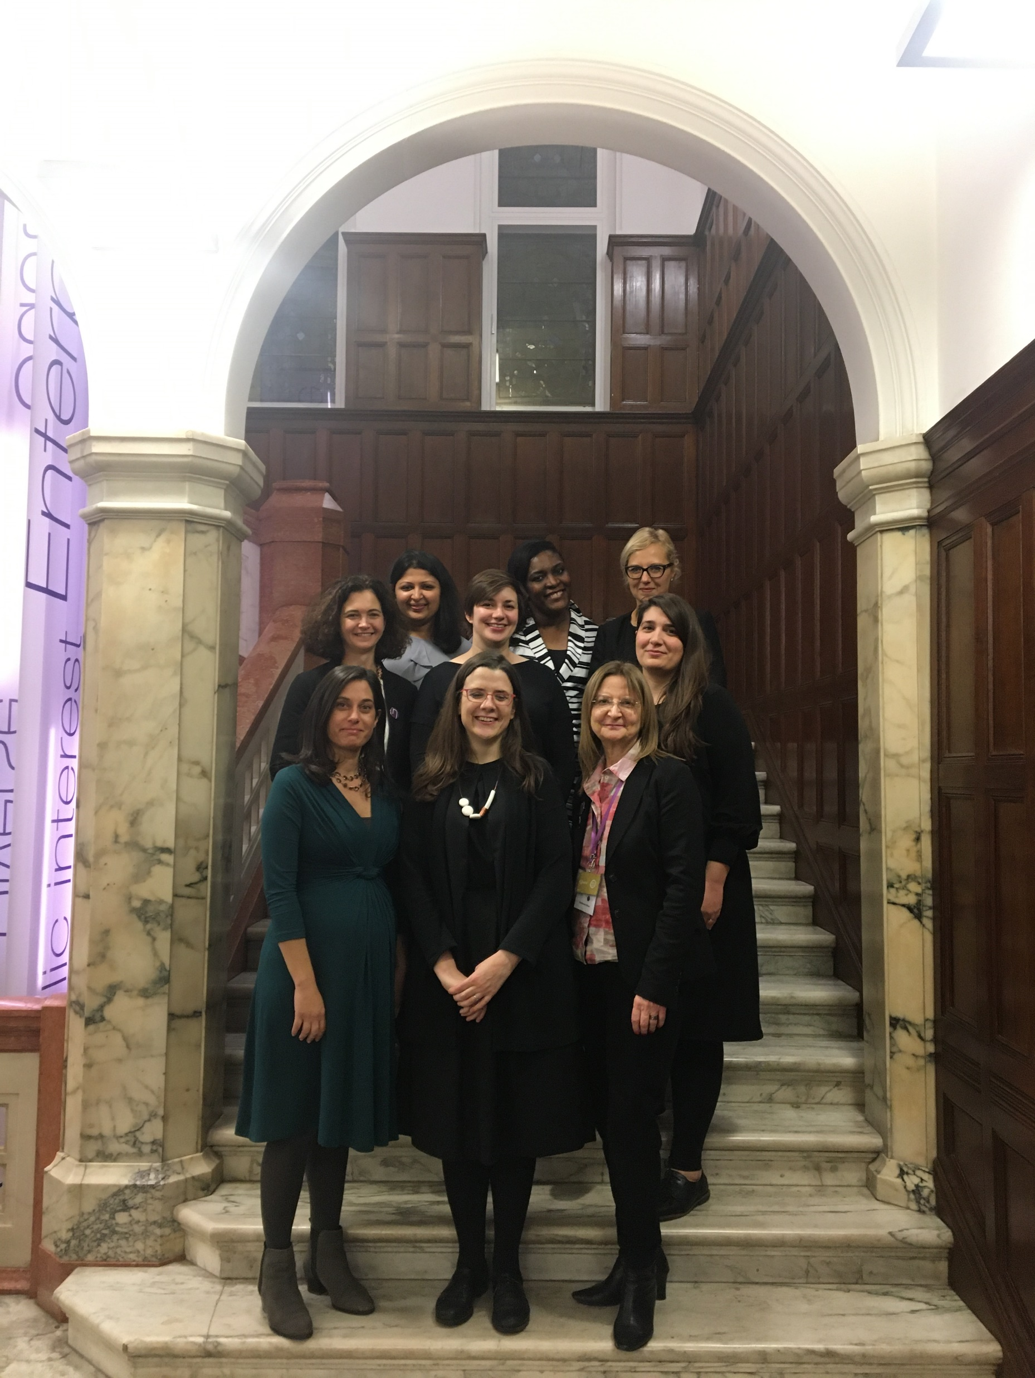
Just before Covid in November 2019, the annual NAWIC conference was held in the RICS. An event where 190 women came one Friday evening from 17.30 to 21.00 to take part in a number of different workshops and listen to experts on many themes.
A triple first for the RICS.
The first ever women’s event for all women, not just VIP or famous female surveyors.
Other professions were welcomed in – architects, engineers, PMs, services consultants. The keynote speaker was a structural engineer who had organised the infrastructure of the Olympics games in 2012 while pregnant with twins.
Never before – or since have the RICS hosted more than 100 people in the building at any one time. They said it was not possible, but NAWIC knew better!
Here are the NAWIC committee at the end of the evening.

Slide 17
